Slide 1



Slide 2

RSA , Cryptography
RSA (Rivest-Shamir-Adleman) is a widely used public key cryptographic system that enables secure data transmission. It relies on the mathematical properties of large prime numbers for encryption and decryption, ensuring privacy and authenticity in digital communications.

Slide 3

RSA relies on:
Key Generation
Choose two large prime numbers (say, p and q), compute n = p × q.
Calculate an exponent e (used for encryption) and a private key d (used for decryption).
Encryption
Convert each letter/message into a number m.
Compute: cipher = m^e mod n.
Decryption
Compute: message = cipher^d mod n.
How RSA Encryption Works

Slide 4

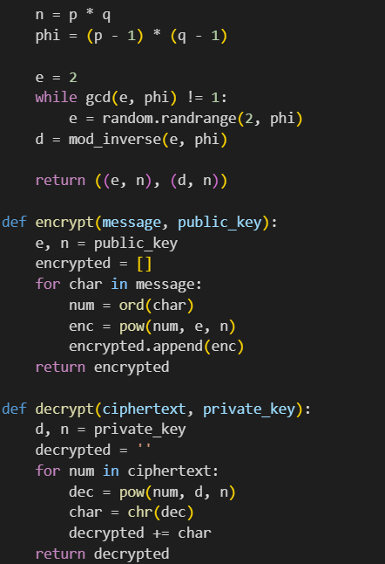

Demo
Public Key: (109, 187)
Private Key: (69, 187)
Enter your text: Hello
Encrypted: [123, 50, 27, 27, 144]
Decrypted: Hello

Slide 5

Why RSA Matters
RSA is the backbone of digital security.
It’s used in HTTPS, VPNs, blockchains, and more.
It enables secure transactions over open networks — like the internet.

Slide 6
“Cryptography is an essential tool that safeguards our information, ensuring privacy and security in an increasingly digital world where data breaches are more common than ever before.”

Slide 7

Made By:
Omar Hany
Jasmin Nasser
Bassant Mohamed
Basmala Salah

